Slide 1
Queue Data Structure and Types
By Dr Shantanu Pathak

Slide 2
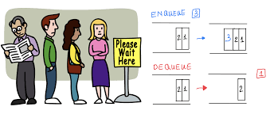
Queue
First In First Out / Last In Last Out
Ex.
Queue for parking
Queue for ticket booking

Slide 3
Queue Data Structure (D,F,A)
Domains:
Queue of requests for ticket booking
Queue of process scheduling
Functions:
Enqueue(): put element at rear of the queue
Dequeue(): remove element from front of the queue
IsEmpty()
IsFull()
Axioms (Assumptions):
Element can ONLY be added at rear of the queue
Element can ONLY be removed from front of the queue
If front == rear then queue is EMPTY

Slide 4
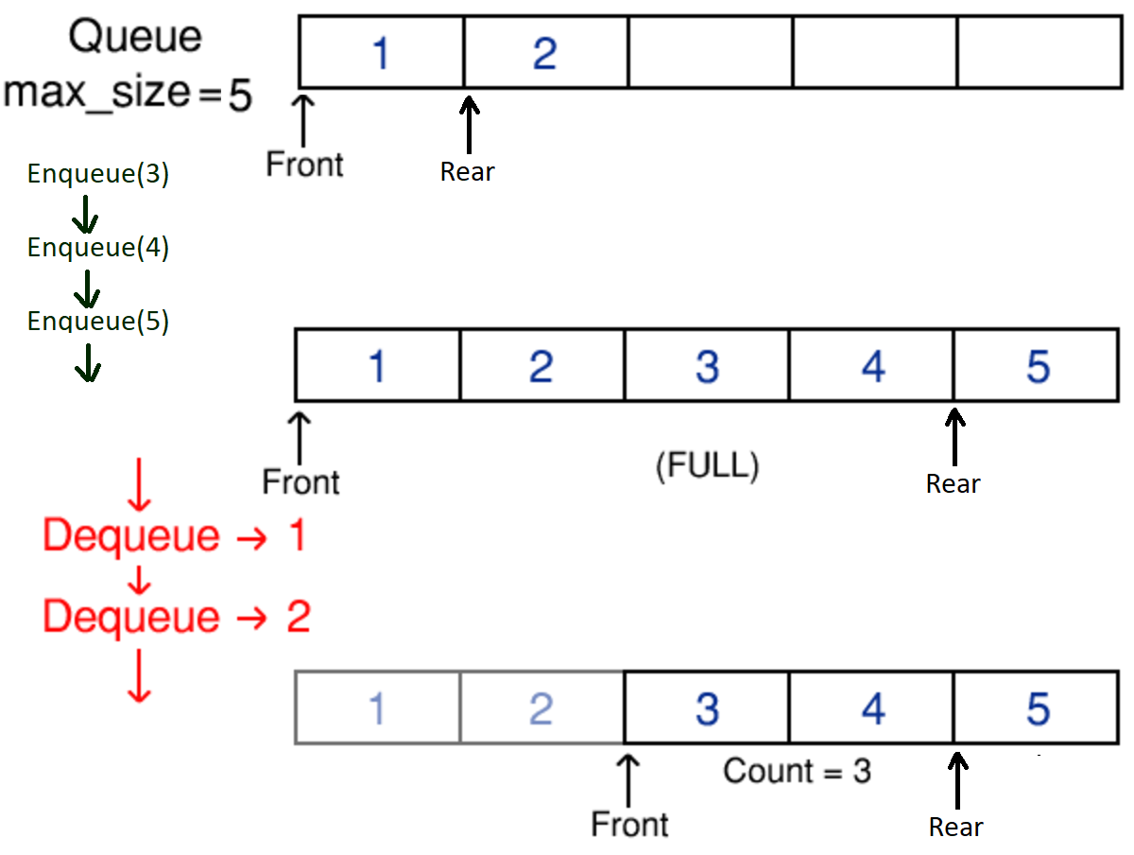
Queue Working

Slide 5
Types of Queues
Queue
Double Ended Queue
Circular Queue
Priority Queue

Slide 6
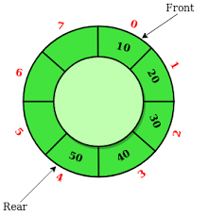
Circular Queue Data Structure
Domains:
Queue of process for round robin scheduling
Functions:
Enqueue(): put element at rear of the queue
Dequeue(): remove element from start of the queue
IsEmpty()
IsFull()
Axioms (Assumptions):
Element can ONLY be added at rear of the queue
Element can ONLY be removed from front of the queue
Queue EMPTY needs special handling (count)
Value of front and rear change in circular manner

Slide 7
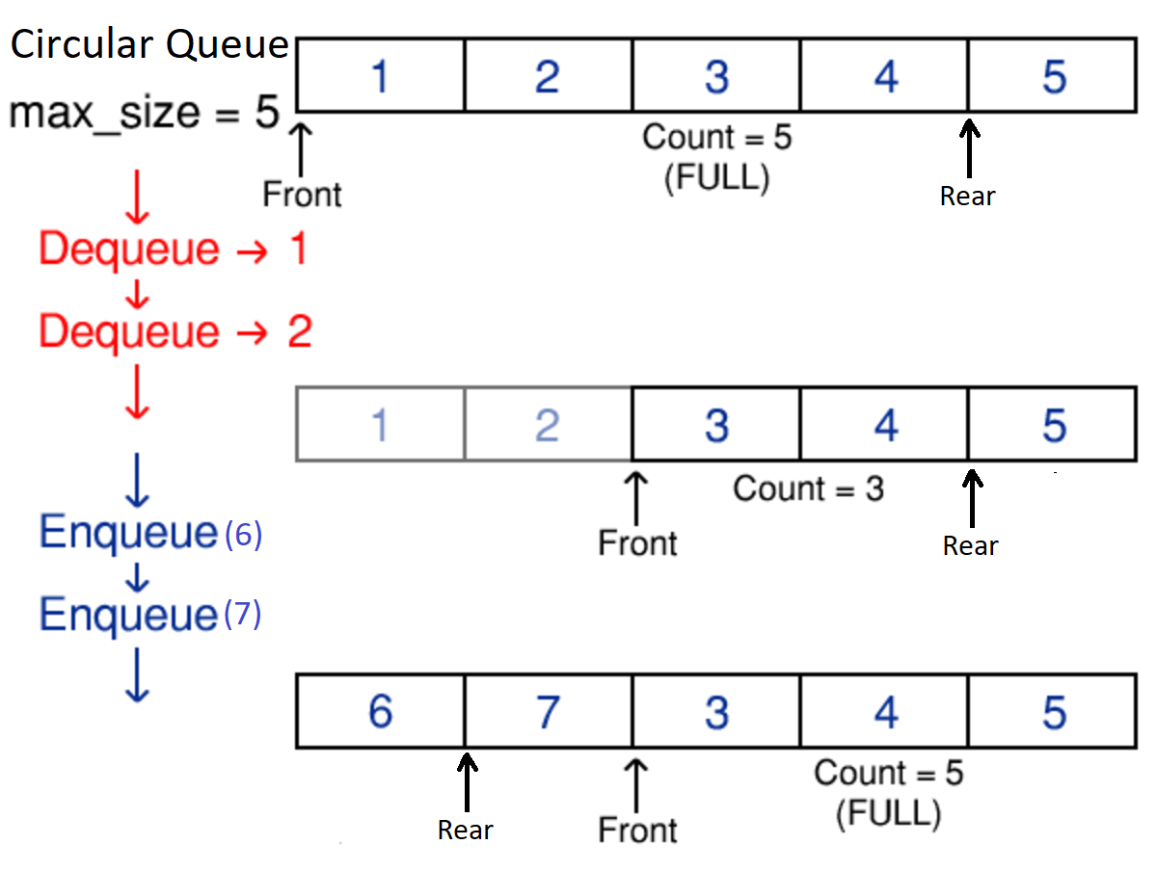
Circular Queue Working

Slide 8
Circular Queue Data Structure
Advantage
When queue is created using array then memory is used efficiently
Dis-advantage
To detect Empty queue needs special handling

Slide 9
Priority Queue Data Structure
Domains:
Queue of requests for loan approval
Queue of requests for hospital admission
Queue of resource allocation at server
( interrupt/user type/etc)
Functions:
Enqueue(): insert element and priority at right place
Dequeue(): remove highest priority element
IsEmpty()
IsFull()
Axioms (Assumptions):
All elements have priority assigned
Whenever element is added, it is put as per its priority

